Slide 1
Quantum Computing for Computer Scientists
The gate quantum computation model
Created by Andrew Helwer

Slide 2
License
This presentation is licensed under CC-BY-SA 4.0, meaning you are free to:
  Share – copy and redistribute the material in any medium or format
  Adapt – remix, transform, and build upon the material for any purpose, even commercially
Under the following terms:
  Attribution – you must give appropriate credit to the licensor, provide a link to the license, and indicate if changes were made. You may do so in any reasonable manner, but not in any way that suggests the licensor endorses you or your use
  ShareAlike – If you remix, transform, or build upon the material, you must distribute your contributions under the same license as the original
Read more about the license here: https://creativecommons.org/licenses/by-sa/4.0/

Slide 3
Errata
Link to talk: https://youtu.be/F_Riqjdh2oM
At 0m54s in the talk I claimed quantum annealing and the gate model "might be equivalent, but the jury's still out on that"; this statement is not quite correct, and you can read more about the topic here.
At 9m54s in the talk (and in an older version of the slides) I claimed all quantum operators are their own inverses; while this is true of all the operators in this presentation, it is not true in general.
At 1h8m25s in the talk I failed to understand a student’s question about how we know the entangled qbits decide how they will collapse at time of measurement, rather than entanglement; this should have been answered with a reference to Bell test experiments.

Slide 4
Changelog
This presentation has been modified from its original form in the video as follows:
  Added “Classical to Quantum” slide
  Added slide defining superposition, and appendix slide on superposition as linear combination
  In Deutsch Oracle explanation, changed Input/Output labels to Control/Target
  Redid Deutsch Oracle circuit diagrams for additional clarity
  Expanded explanation of entanglement and its relation to Bell test experiments
  Added “Sources” slide crediting material I used to learn & create this presentation
  Fixed bit & gate order issues in entanglement & teleportation slides
  Many other minor stylistic changes

Slide 5
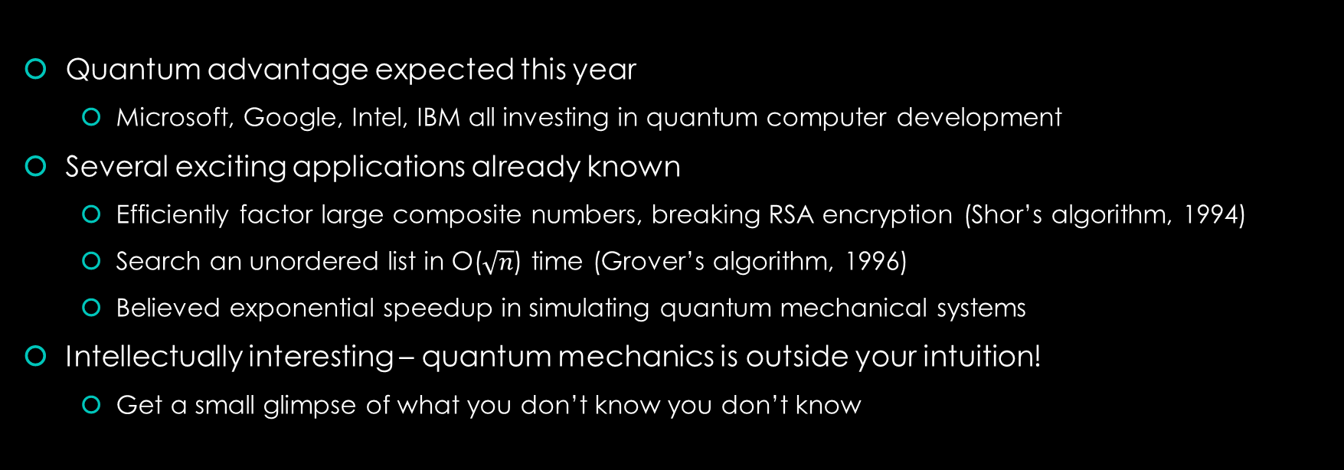
Why learn quantum computing?
Quantum advantage expected this year
  Microsoft, Google, Intel, IBM all investing in quantum computer development
Several exciting applications already known
  Efficiently factor large composite numbers, breaking RSA encryption (Shor’s algorithm, 1994)
  Search an unordered list in O($\sqrt{n}$) time (Grover’s algorithm, 1996)
  Believed exponential speedup in simulating quantum mechanical systems
Intellectually interesting – quantum mechanics is outside your intuition!
  Get a small glimpse of what you don’t know you don’t know
Notes:
Wittgenstein: “The limits of my language mean the limits of my world”
Our language developed in a classical world, and so quantum mechanics perhaps exists outside our language
To understand quantum mechanics, we must learn a new language: mathematics
All attempts to understand quantum mechanics through informal metaphors are doomed to failure
David Mermin: “Shut up and calculate!”

Slide 6
Learning objectives
Representing computation with basic linear algebra (vectors and matrices)
Qbits, superposition, and quantum logic gates
The simplest problem where a quantum computer beats a classical computer
Bonus topics: quantum entanglement and teleportation

Slide 7
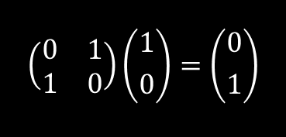
Classical to quantum
Classical Computing
States are bits (0 or 1)
Gates are Boolean logic operators
0 ∧ 1 = 0 0 ∨ 1 = 1 ¬0 = 1
Quantum Computing
States are vectors
Gates are matrices
$$\left(\begin{matrix}0 & 1 \\ 1 & 0\end{matrix}\right)\left({1 \atop 0}\right)=\left({0 \atop 1}\right)$$
Notes:
Quantum computers do not work by trying every possible solution simultaneously
Quantum computers can run any classical algorithm

Slide 8
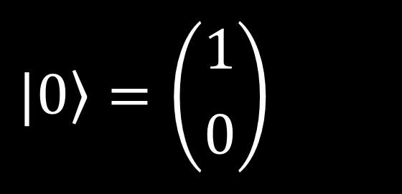
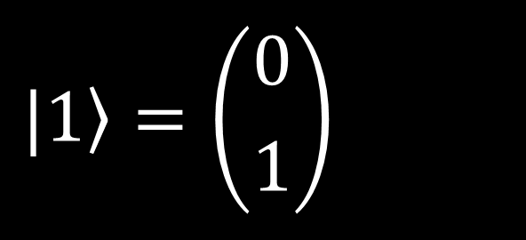


Representing classical bits as a vector
One bit with the value 0, also written as $|\left.0\right\rangle$ (Dirac vector notation)
$$|\left.0\right\rangle =\left({1 \atop 0}\right)$$
One bit with the value 1, also written as $|\left.1\right\rangle$
$$|\left.1\right\rangle =\left({0 \atop 1}\right)$$

Slide 9
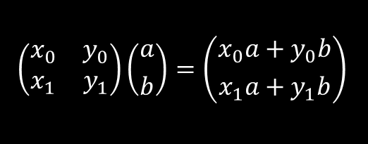



Review: matrix multiplication
$$\left(\begin{matrix}x_{0} & y_{0} \\ x_{1} & y_{1}\end{matrix}\right)\left({a \atop b}\right)=\left({x_{0}a+y_{0}b \atop x_{1}a+y_{1}b}\right)$$
$$\left(\begin{matrix}1 & 0 & \begin{matrix}0 & 0\end{matrix} \\ 0 & 1 & \begin{matrix}0 & 0\end{matrix} \\ \begin{matrix}0 \\ 0\end{matrix} & \begin{matrix}0 \\ 0\end{matrix} & \begin{matrix}\begin{matrix}1 & 0\end{matrix} \\ \begin{matrix}0 & 1\end{matrix}\end{matrix}\end{matrix}\right)\left(\begin{matrix}a \\ b \\ \begin{matrix}c \\ d\end{matrix}\end{matrix}\right)=\left(\begin{matrix}a \\ b \\ \begin{matrix}c \\ d\end{matrix}\end{matrix}\right)$$
$$\left(\begin{matrix}x_{0} & y_{0} & \begin{matrix}z_{0} & w_{0}\end{matrix} \\ x_{1} & y_{1} & \begin{matrix}z_{1} & w_{1}\end{matrix} \\ \begin{matrix}x_{2} \\ x_{3}\end{matrix} & \begin{matrix}y_{2} \\ y_{3}\end{matrix} & \begin{matrix}\begin{matrix}z_{2} & w_{2}\end{matrix} \\ \begin{matrix}z_{3} & w_{3}\end{matrix}\end{matrix}\end{matrix}\right)\left(\begin{matrix}a \\ b \\ \begin{matrix}c \\ d\end{matrix}\end{matrix}\right)=\left(\begin{matrix}x_{0}a+y_{0}b+z_{0}c+w_{0}d \\ x_{1}a+y_{1}b+z_{1}c+w_{1}d \\ \begin{matrix}x_{2}a+y_{2}b+z_{2}c+w_{2}d \\ x_{3}a+y_{3}b+z_{3}c+w_{3}d\end{matrix}\end{matrix}\right)$$
$$\left(\begin{matrix}1 & 0 & \begin{matrix}0 & 0\end{matrix} \\ 0 & 0 & \begin{matrix}1 & 0\end{matrix} \\ \begin{matrix}0 \\ 0\end{matrix} & \begin{matrix}1 \\ 0\end{matrix} & \begin{matrix}\begin{matrix}0 & 0\end{matrix} \\ \begin{matrix}0 & 1\end{matrix}\end{matrix}\end{matrix}\right)\left(\begin{matrix}0 \\ 1 \\ \begin{matrix}0 \\ 0\end{matrix}\end{matrix}\right)=\left(\begin{matrix}0 \\ 0 \\ \begin{matrix}1 \\ 0\end{matrix}\end{matrix}\right)$$

Slide 10
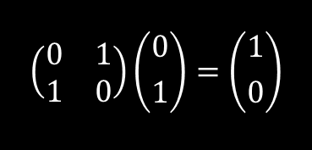
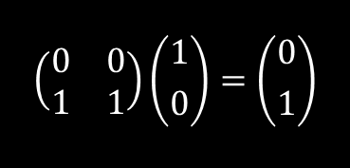

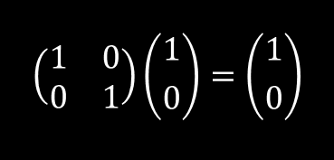

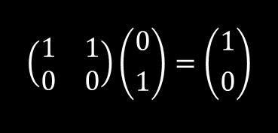



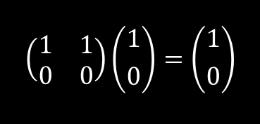



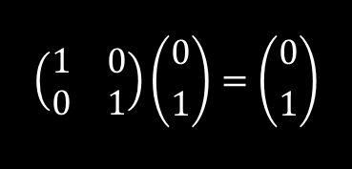

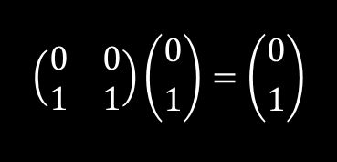
Operations on one classical bit (cbit)
$$\left(\begin{matrix}1 & 0 \\ 0 & 1\end{matrix}\right)\left({1 \atop 0}\right)=\left({1 \atop 0}\right)$$
$$\left(\begin{matrix}1 & 0 \\ 0 & 1\end{matrix}\right)\left({0 \atop 1}\right)=\left({0 \atop 1}\right)$$
Identity
$$f\left(x\right)=x$$
$$0$$
$$0$$
$$1$$
$$1$$
$$\left(\begin{matrix}0 & 1 \\ 1 & 0\end{matrix}\right)\left({1 \atop 0}\right)=\left({0 \atop 1}\right)$$
$$\left(\begin{matrix}0 & 1 \\ 1 & 0\end{matrix}\right)\left({0 \atop 1}\right)=\left({1 \atop 0}\right)$$
Negation
$$f\left(x\right)=¬x$$
$$0$$
$$0$$
$$1$$
$$1$$
$$\left(\begin{matrix}1 & 1 \\ 0 & 0\end{matrix}\right)\left({1 \atop 0}\right)=\left({1 \atop 0}\right)$$
$$\left(\begin{matrix}1 & 1 \\ 0 & 0\end{matrix}\right)\left({0 \atop 1}\right)=\left({1 \atop 0}\right)$$
Constant-0
$$f\left(x\right)=0$$
$$0$$
$$0$$
$$1$$
$$1$$
$$\left(\begin{matrix}0 & 0 \\ 1 & 1\end{matrix}\right)\left({1 \atop 0}\right)=\left({0 \atop 1}\right)$$
$$\left(\begin{matrix}0 & 0 \\ 1 & 1\end{matrix}\right)\left({0 \atop 1}\right)=\left({0 \atop 1}\right)$$
Constant-1
$$f\left(x\right)=1$$
$$0$$
$$0$$
$$1$$
$$1$$

Slide 11
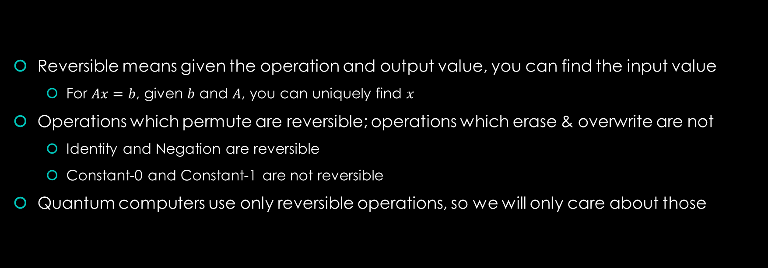
Reversible computing
Reversible means given the operation and output value, you can find the input value
  For $Ax=b$, given $b$ and $A$, you can uniquely find $x$
Operations which permute are reversible; operations which erase & overwrite are not
  Identity and Negation are reversible
  Constant-0 and Constant-1 are not reversible
Quantum computers use only reversible operations, so we will only care about those
Notes:
In technical terms, all quantum computing operators U are Unitary (their adjoint [conjugate-transpose] is their inverse, so UU* = U*U = 1); as a corollary, they all must have an inverse and are therefore reversible.
Classical reversible computing theoretically requires zero energy, since it generates no entropy
Might be able to move computers beyond the von Neumann-Landauer limit!

Slide 12
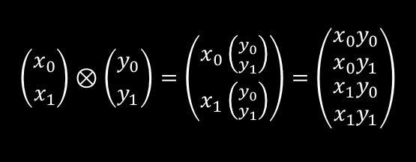


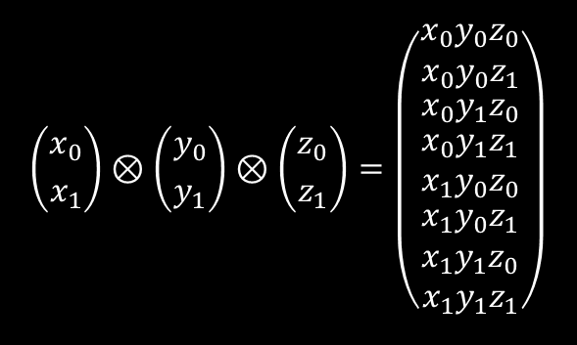
Review: tensor product of vectors
$$\left({x_{0} \atop x_{1}}\right)⊗\left({y_{0} \atop y_{1}}\right)=\left({x_{0}\left({y_{0} \atop y_{1}}\right) \atop x_{1}\left({y_{0} \atop y_{1}}\right)}\right)=\left(\begin{matrix}x_{0}y_{0} \\ x_{0}y_{1} \\ \begin{matrix}x_{1}y_{0} \\ x_{1}y_{1}\end{matrix}\end{matrix}\right)$$
$$\left({1 \atop 2}\right)⊗\left({3 \atop 4}\right)=\left(\begin{matrix}3 \\ 4 \\ \begin{matrix}6 \\ 8\end{matrix}\end{matrix}\right)$$
$$\left({x_{0} \atop x_{1}}\right)⊗\left({y_{0} \atop y_{1}}\right)⊗\left({z_{0} \atop z_{1}}\right)=\left(\begin{matrix}x_{0}y_{0}z_{0} \\ x_{0}y_{0}z_{1} \\ \begin{matrix}x_{0}y_{1}z_{0} \\ \begin{matrix}x_{0}y_{1}z_{1} \\ x_{1}y_{0}z_{0} \\ \begin{matrix}x_{1}y_{0}z_{1} \\ x_{1}y_{1}z_{0} \\ x_{1}y_{1}z_{1}\end{matrix}\end{matrix}\end{matrix}\end{matrix}\right)$$
$$\left({0 \atop 1}\right)⊗\left({0 \atop 1}\right)⊗\left({1 \atop 0}\right)=\left(\begin{matrix}\begin{matrix}\begin{matrix}0 \\ 0 \\ 0\end{matrix} \\ 0\end{matrix} \\ \begin{matrix}0 \\ \begin{matrix}0 \\ \begin{matrix}1 \\ 0\end{matrix}\end{matrix}\end{matrix}\end{matrix}\right)$$
Notes:
Notice that the tensor product of our zero/one vectors result in an all-zero vector except for a single 1
Notice also that the subscripts form a binary counter

Slide 13

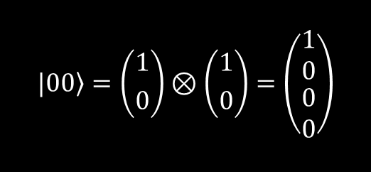
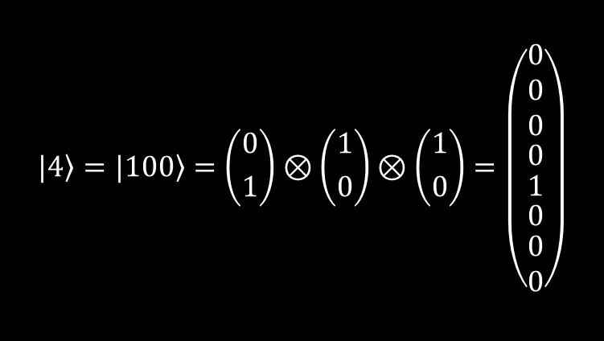
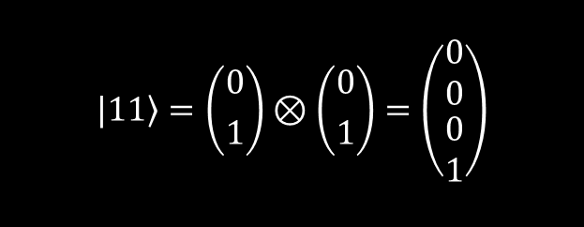
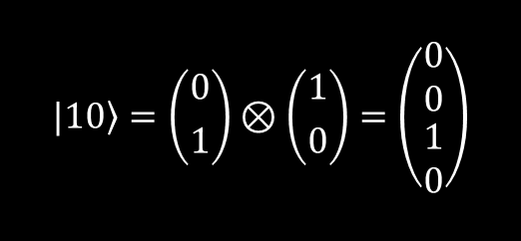
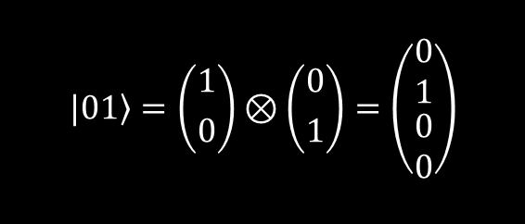
Representing multiple cbits
$$|\left.00\right\rangle =\left({1 \atop 0}\right)⊗\left({1 \atop 0}\right)=\left(\begin{matrix}1 \\ 0 \\ \begin{matrix}0 \\ 0\end{matrix}\end{matrix}\right)$$
$$|\left.01\right\rangle =\left({1 \atop 0}\right)⊗\left({0 \atop 1}\right)=\left(\begin{matrix}0 \\ 1 \\ \begin{matrix}0 \\ 0\end{matrix}\end{matrix}\right)$$
$$\left.|4\right\rangle =|\left.100\right\rangle =\left({0 \atop 1}\right)⊗\left({1 \atop 0}\right)⊗\left({1 \atop 0}\right)=\left(\begin{matrix}\begin{matrix}\begin{matrix}0 \\ 0 \\ 0\end{matrix} \\ 0\end{matrix} \\ \begin{matrix}1 \\ \begin{matrix}0 \\ \begin{matrix}0 \\ 0\end{matrix}\end{matrix}\end{matrix}\end{matrix}\right)$$
$$|\left.10\right\rangle =\left({0 \atop 1}\right)⊗\left({1 \atop 0}\right)=\left(\begin{matrix}0 \\ 0 \\ \begin{matrix}1 \\ 0\end{matrix}\end{matrix}\right)$$
$$|\left.11\right\rangle =\left({0 \atop 1}\right)⊗\left({0 \atop 1}\right)=\left(\begin{matrix}0 \\ 0 \\ \begin{matrix}0 \\ 1\end{matrix}\end{matrix}\right)$$
We call this tensored representation the product state
We can factor the product state back into the individual state representation
The product state of $n$ bits is a vector of size $2^{n}$
Notes:
Notice that the product state of binary number x has a 1 in the xth row, for example 10 (2) has a 1 in the 2nd row (counting from 0)

Slide 14





Operations on multiple cbits: CNOT
Operates on pairs of bits, one of which is the “control” bit and the other the “target” bit
If the control bit is 1, then the target bit is flipped
If the control bit is 0, then the target bit is unchanged
The control bit is always unchanged
With most-significant bit as control and least-significant bit as target, action is as follows:
$$00$$
$$00$$
$$C=\left(\begin{matrix}\begin{matrix}1 & 0 \\ 0 & 1\end{matrix} & \begin{matrix}0 & 0 \\ 0 & 0\end{matrix} \\ \begin{matrix}0 & 0 \\ 0 & 0\end{matrix} & \begin{matrix}0 & 1 \\ 1 & 0\end{matrix}\end{matrix}\right)$$
$$01$$
$$01$$
$$10$$
$$10$$
$$11$$
$$11$$
Notes:
Toffoli gate (CNOT gate with two control bits) is functionally complete – like a NAND gate in classical computing

Slide 15
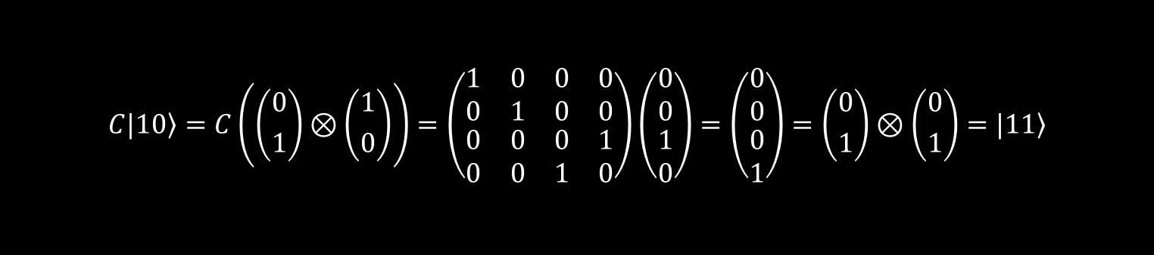
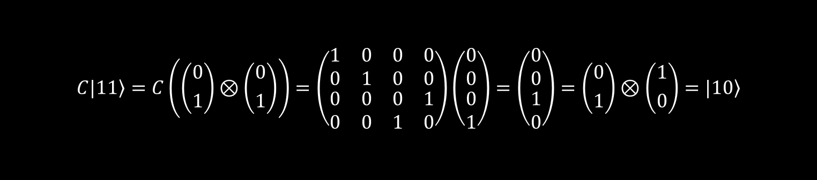
Operations on multiple cbits: CNOT
$$C|\left.10\right\rangle =C\left(\left({0 \atop 1}\right)⊗\left({1 \atop 0}\right)\right)=\left(\begin{matrix}\begin{matrix}1 & 0 \\ 0 & 1\end{matrix} & \begin{matrix}0 & 0 \\ 0 & 0\end{matrix} \\ \begin{matrix}0 & 0 \\ 0 & 0\end{matrix} & \begin{matrix}0 & 1 \\ 1 & 0\end{matrix}\end{matrix}\right)\left(\begin{matrix}0 \\ 0 \\ \begin{matrix}1 \\ 0\end{matrix}\end{matrix}\right)=\left(\begin{matrix}0 \\ 0 \\ \begin{matrix}0 \\ 1\end{matrix}\end{matrix}\right)=\left({0 \atop 1}\right)⊗\left({0 \atop 1}\right)=|\left.11\right\rangle$$
$$C|\left.11\right\rangle =C\left(\left({0 \atop 1}\right)⊗\left({0 \atop 1}\right)\right)=\left(\begin{matrix}\begin{matrix}1 & 0 \\ 0 & 1\end{matrix} & \begin{matrix}0 & 0 \\ 0 & 0\end{matrix} \\ \begin{matrix}0 & 0 \\ 0 & 0\end{matrix} & \begin{matrix}0 & 1 \\ 1 & 0\end{matrix}\end{matrix}\right)\left(\begin{matrix}0 \\ 0 \\ \begin{matrix}0 \\ 1\end{matrix}\end{matrix}\right)=\left(\begin{matrix}0 \\ 0 \\ \begin{matrix}1 \\ 0\end{matrix}\end{matrix}\right)=\left({0 \atop 1}\right)⊗\left({1 \atop 0}\right)=|\left.10\right\rangle$$

Slide 16
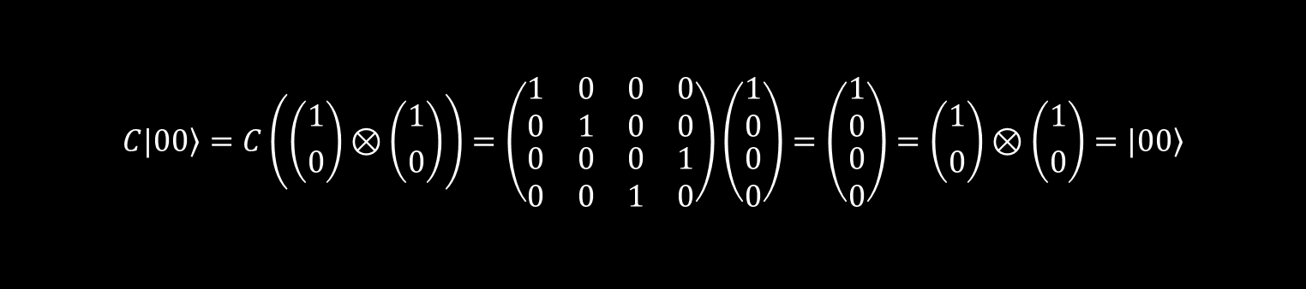
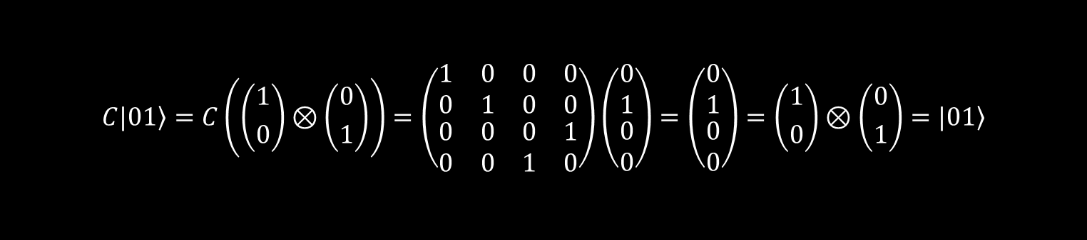
Operations on multiple cbits: CNOT
$$C|\left.00\right\rangle =C\left(\left({1 \atop 0}\right)⊗\left({1 \atop 0}\right)\right)=\left(\begin{matrix}\begin{matrix}1 & 0 \\ 0 & 1\end{matrix} & \begin{matrix}0 & 0 \\ 0 & 0\end{matrix} \\ \begin{matrix}0 & 0 \\ 0 & 0\end{matrix} & \begin{matrix}0 & 1 \\ 1 & 0\end{matrix}\end{matrix}\right)\left(\begin{matrix}1 \\ 0 \\ \begin{matrix}0 \\ 0\end{matrix}\end{matrix}\right)=\left(\begin{matrix}1 \\ 0 \\ \begin{matrix}0 \\ 0\end{matrix}\end{matrix}\right)=\left({1 \atop 0}\right)⊗\left({1 \atop 0}\right)=|\left.00\right\rangle$$
$$C|\left.01\right\rangle =C\left(\left({1 \atop 0}\right)⊗\left({0 \atop 1}\right)\right)=\left(\begin{matrix}\begin{matrix}1 & 0 \\ 0 & 1\end{matrix} & \begin{matrix}0 & 0 \\ 0 & 0\end{matrix} \\ \begin{matrix}0 & 0 \\ 0 & 0\end{matrix} & \begin{matrix}0 & 1 \\ 1 & 0\end{matrix}\end{matrix}\right)\left(\begin{matrix}0 \\ 1 \\ \begin{matrix}0 \\ 0\end{matrix}\end{matrix}\right)=\left(\begin{matrix}0 \\ 1 \\ \begin{matrix}0 \\ 0\end{matrix}\end{matrix}\right)=\left({1 \atop 0}\right)⊗\left({0 \atop 1}\right)=|\left.01\right\rangle$$
Notes:
Intuition: for the product state vector, the top two rows have a 1 when the value is 00 or 01; thus, the control bit is zero and they should be unchanged. We see the top two rows of the CNOT matrix indeed are like the identity matrix so leave the product state unchanged. The bottom two rows have a 1 when the value is 10 or 11, so the control bit is 1 and the target bit should be flipped. We see that the bottom two rows of the CNOT matrix indeed have this action.

Slide 17
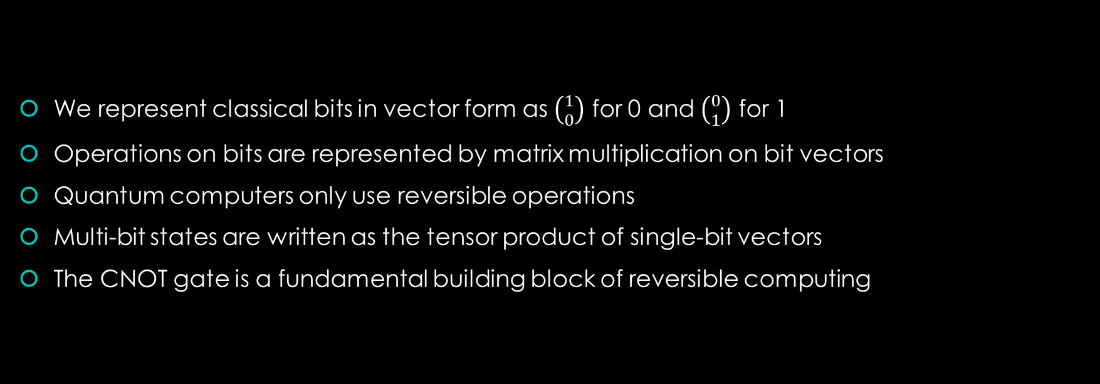
Recap
We represent classical bits in vector form as $\left({1 \atop 0}\right)$ for 0 and $\left({0 \atop 1}\right)$ for 1
Operations on bits are represented by matrix multiplication on bit vectors
Quantum computers only use reversible operations
Multi-bit states are written as the tensor product of single-bit vectors
The CNOT gate is a fundamental building block of reversible computing

Slide 18
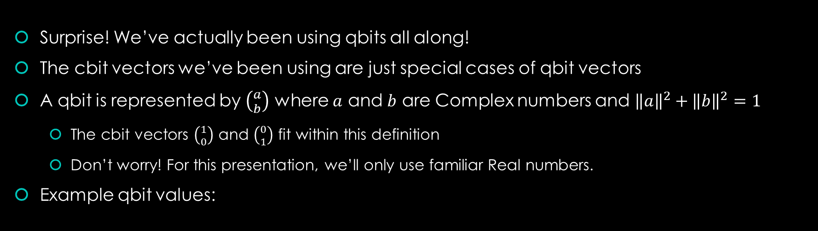

Qbits and superposition
Surprise! We’ve actually been using qbits all along!
The cbit vectors we’ve been using are just special cases of qbit vectors
A qbit is represented by $\left({a \atop b}\right)$ where $a$ and $b$ are Complex numbers and ${\left\|a\right\|}^{2}+{\left\|b\right\|}^{2}=1$
  The cbit vectors $\left({1 \atop 0}\right)$ and $\left({0 \atop 1}\right)$ fit within this definition
  Don’t worry! For this presentation, we’ll only use familiar Real numbers.
Example qbit values:
$$\left({\frac{1}{\sqrt{2}} \atop \frac{1}{\sqrt{2}}}\right) \left({\frac{1}{2} \atop \frac{\sqrt{3}}{2}}\right) \left({−1 \atop 0}\right) \left({\frac{1}{\sqrt{2}} \atop \frac{−1}{\sqrt{2}}}\right)$$

Slide 19
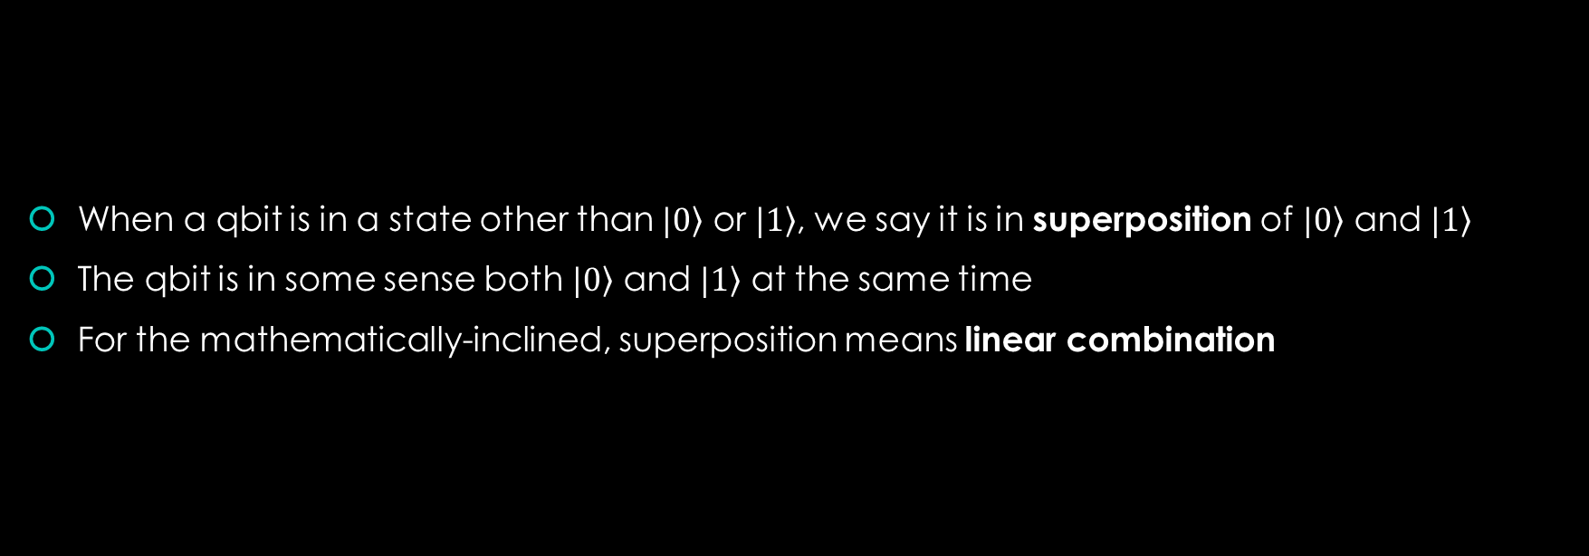
Superposition
When a qbit is in a state other than $|\left.0\right\rangle$ or $|\left.1\right\rangle$, we say it is in superposition of $|\left.0\right\rangle$ and $|\left.1\right\rangle$
The qbit is in some sense both $|\left.0\right\rangle$ and $|\left.1\right\rangle$ at the same time
For the mathematically-inclined, superposition means linear combination

Slide 20
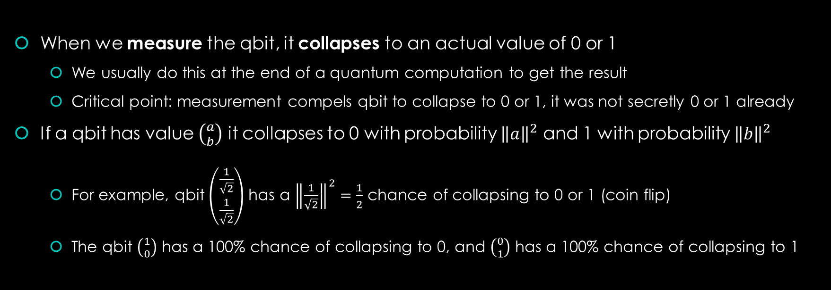
Measurement
When we measure the qbit, it collapses to an actual value of 0 or 1
  We usually do this at the end of a quantum computation to get the result
  Critical point: measurement compels qbit to collapse to 0 or 1, it was not secretly 0 or 1 already
If a qbit has value $\left({a \atop b}\right)$ it collapses to 0 with probability ${\left\|a\right\|}^{2}$ and 1 with probability ${\left\|b\right\|}^{2}$
  For example, qbit $\left(\begin{matrix}\frac{1}{\sqrt{2}} \\ \frac{1}{\sqrt{2}}\end{matrix}\right)$ has a ${\left\|\frac{1}{\sqrt{2}}\right\|}^{2}=\frac{1}{2}$ chance of collapsing to 0 or 1 (coin flip)
  The qbit $\left({1 \atop 0}\right)$ has a 100% chance of collapsing to 0, and $\left({0 \atop 1}\right)$ has a 100% chance of collapsing to 1
Notes:
Real-life qbits use a binary quantum property like spin or polarization for superposition
Polarization here is the same phenomenon you see in fancy sunglasses
(simplifying) a photon can be polarized in one of two directions, vertical or horizontal
It can also be in a superposition of vertical and horizontal polarization
You measure a photon in polarization superposition by shooting it through a vertical or horizontal polarization grate and seeing whether it gets through to hit a detector on the other side.
You can measure spin by shooting electrons through a magnetic field and seeing which way they curve
In a limited way, superposition lets us compute with the values of 0 and 1 at the same time
Note: it is not that we simply don’t know whether the qbit is 0 or 1, but that it literally is both at the same time (the idea that a qbit is secretly 0 or 1 is called hidden variable theory and was disproved in 1964 basically)

Slide 21
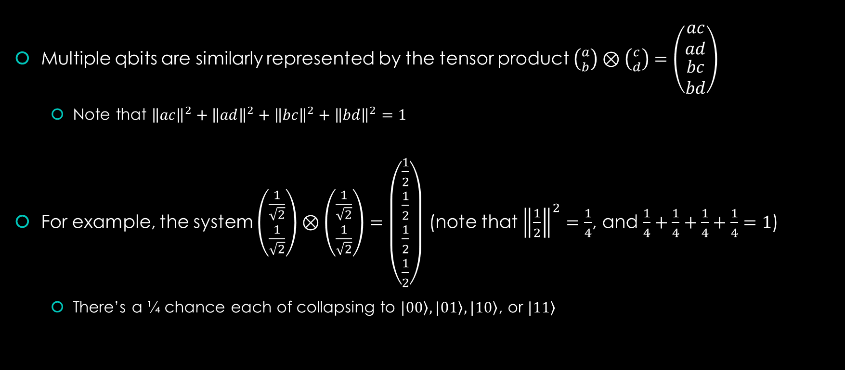
Multiple qbits
Multiple qbits are similarly represented by the tensor product $\left({a \atop b}\right)⊗\left({c \atop d}\right)=\left(\begin{matrix}ac \\ ad \\ \begin{matrix}bc \\ bd\end{matrix}\end{matrix}\right)$
  Note that ${\left\|ac\right\|}^{2}+{\left\|ad\right\|}^{2}+{\left\|bc\right\|}^{2}+{\left\|bd\right\|}^{2}=1$
For example, the system $\left(\begin{matrix}\frac{1}{\sqrt{2}} \\ \frac{1}{\sqrt{2}}\end{matrix}\right)⊗\left(\begin{matrix}\frac{1}{\sqrt{2}} \\ \frac{1}{\sqrt{2}}\end{matrix}\right)=\left(\begin{matrix}\frac{1}{2} \\ \frac{1}{2} \\ \begin{matrix}\frac{1}{2} \\ \frac{1}{2}\end{matrix}\end{matrix}\right)$ (note that ${\left\|\frac{1}{2}\right\|}^{2}=\frac{1}{4}$, and $\frac{1}{4}+\frac{1}{4}+\frac{1}{4}+\frac{1}{4}=1$)
  There’s a ¼ chance each of collapsing to $\left.|00\right\rangle , \left.|01\right\rangle ,\left.|10\right\rangle$, or $\left.|11\right\rangle$

Slide 22

Operations on qbits
How do we operate on qbits? The same way we operate on cbits: with matrices!
All the matrix operators we’ve seen also work on qbits (bit flip, CNOT, etc.)
Matrix operators model the effect of some device which manipulates qbit spin/polarization without measuring and collapsing it
$$\left(\begin{matrix}0 & 1 \\ 1 & 0\end{matrix}\right)\left({\frac{1}{2} \atop \frac{\sqrt{3}}{2}}\right)=\left({\frac{\sqrt{3}}{2} \atop \frac{1}{2}}\right)$$
There are several important matrix operators which only make sense in a quantum context

Slide 23


The Hadamard gate
The Hadamard gate takes a 0- or 1-bit and puts it into exactly equal superposition
$$H\left.|0\right\rangle =\left(\begin{matrix}\frac{1}{\sqrt{2}} & \frac{1}{\sqrt{2}} \\ \frac{1}{\sqrt{2}} & \frac{−1}{\sqrt{2}}\end{matrix}\right)\left({1 \atop 0}\right)=\left({\frac{1}{\sqrt{2}} \atop \frac{1}{\sqrt{2}}}\right)$$
$$H\left.|1\right\rangle =\left(\begin{matrix}\frac{1}{\sqrt{2}} & \frac{1}{\sqrt{2}} \\ \frac{1}{\sqrt{2}} & \frac{−1}{\sqrt{2}}\end{matrix}\right)\left({0 \atop 1}\right)=\left({\frac{1}{\sqrt{2}} \atop \frac{−1}{\sqrt{2}}}\right)$$

Slide 24


The Hadamard gate
The Hadamard gate also takes a qbit in equal superposition back into a 0- or 1-bit!
$$\left(\begin{matrix}\frac{1}{\sqrt{2}} & \frac{1}{\sqrt{2}} \\ \frac{1}{\sqrt{2}} & \frac{−1}{\sqrt{2}}\end{matrix}\right)\left({\frac{1}{\sqrt{2}} \atop \frac{1}{\sqrt{2}}}\right)=\left({1 \atop 0}\right)$$
$$\left(\begin{matrix}\frac{1}{\sqrt{2}} & \frac{1}{\sqrt{2}} \\ \frac{1}{\sqrt{2}} & \frac{−1}{\sqrt{2}}\end{matrix}\right)\left({\frac{1}{\sqrt{2}} \atop \frac{−1}{\sqrt{2}}}\right)=\left({0 \atop 1}\right)$$
We can transition out of superposition without measurement!
We can thus structure quantum computation deterministically instead of probabilistically
Notes:
The set of quantum algorithms which behave deterministically belong to the complexity class EQP, which stands for Exact Quantum Polynomial time. Note that many useful algorithms do not terminate deterministically; Shor’s algorithm for factoring integers only gives the right answer half the time.

Slide 25
















The unit circle state machine
X
H
$$\left({0 \atop 1}\right)$$
$$\left({0 \atop 1}\right)$$
$$\left({\frac{−1}{\sqrt{2}} \atop \frac{1}{\sqrt{2}}}\right)$$
$$\left({\frac{1}{\sqrt{2}} \atop \frac{1}{\sqrt{2}}}\right)$$
$$\left({\frac{−1}{\sqrt{2}} \atop \frac{1}{\sqrt{2}}}\right)$$
$$\left({\frac{1}{\sqrt{2}} \atop \frac{1}{\sqrt{2}}}\right)$$
$$\left({−1 \atop 0}\right)$$
$$\left({1 \atop 0}\right)$$
$$\left({−1 \atop 0}\right)$$
$$\left({1 \atop 0}\right)$$
$$\left({\frac{−1}{\sqrt{2}} \atop \frac{−1}{\sqrt{2}}}\right)$$
$$\left({\frac{1}{\sqrt{2}} \atop \frac{−1}{\sqrt{2}}}\right)$$
$$\left({\frac{−1}{\sqrt{2}} \atop \frac{−1}{\sqrt{2}}}\right)$$
$$\left({\frac{1}{\sqrt{2}} \atop \frac{−1}{\sqrt{2}}}\right)$$
$$\left({0 \atop −1}\right)$$
$$\left({0 \atop −1}\right)$$
Notes:
X is negation, and H is Hadamard
If we include complex numbers, this would actually be the unit sphere (called the Bloch sphere).

Slide 26


The unit circle state machine
$$\left({0 \atop 1}\right)$$
$$\left({\frac{−1}{\sqrt{2}} \atop \frac{1}{\sqrt{2}}}\right)$$
$$\left({\frac{1}{\sqrt{2}} \atop \frac{1}{\sqrt{2}}}\right)$$
$$\left({−1 \atop 0}\right)$$
$$\left({1 \atop 0}\right)$$
$$\left({1 \atop 0}\right)$$
X
H
X
H
X
$$\left({−1 \atop 0}\right)$$
$$\left({\frac{−1}{\sqrt{2}} \atop \frac{−1}{\sqrt{2}}}\right)$$
$$\left({\frac{1}{\sqrt{2}} \atop \frac{−1}{\sqrt{2}}}\right)$$
$$\left({0 \atop −1}\right)$$
Notes:
This slide introduces quantum circuit notation.
Note that the middle bit flip gate is sort of neutralized by the qbit being in superposition – without the Hadamard gates, there are three bit flip gates, which in classical computing is always equivalent in action to a single bit flip gate. Not so in quantum computing. We make use of this “neutralization” ability later.

Slide 27
Recap
Cbits are just a special case of qbits, which are 2-vectors of Complex numbers
Qbits can be in superposition, and are probabilistically collapsed to cbits by measurement
Multi-qbit systems are tensor products of single-qbit systems, like with cbits
Matrices represent operations on qbits, same as with cbits
The Hadamard gate takes 0- and 1-bits to equal superposition, and back
We can think of qbits and their operations as forming a state machine on the unit circle
  Actually the unit sphere if we use complex numbers

Slide 28
The Deutsch oracle
Imagine someone gives you a black box containing a function on one bit
  Recall! What are the four possible functions on one bit?
You don’t know which function is inside the box, but can try inputs and see outputs
How many queries would it take to determine the function on a classical computer?
How many on a quantum computer?
Notes:
It would take two queries on both a classical and quantum computer
This "gotcha" question is intended to illustrate that quantum computers are not all-powerful things which compute with both 0 and 1 at the same time, because at the end of the day (after measurement) you only end up with a single bit.

Slide 29
The Deutsch oracle
What if you want to check whether the unknown function is constant, or variable?
  Constant-0 & constant-1 are constant, identity & negation are variable
How many queries would it take on a classical computer?
How many on a quantum computer?
Notes:
It would take two queries on a classical computer, but only one on a quantum computer

Slide 30
The Deutsch oracle
How can it be done in a single query!? Superposition!
First, we must define what each of the four functions look like on a quantum computer
  We have an immediate problem with the constant functions
Notes:
The immediate problem is that the constant functions are not reversible, so how can you implement them on a quantum computer which (recall) only performs reversible operations?

Slide 31










Reversable-izing non-reversible functions
We often need to compute non-reversible functions on quantum computers
There is a standard solution! Consider non-reversible function $f$:
$$\left.|x\right\rangle$$
BB
$$\left.|x\right\rangle$$
$$\left.|x\right\rangle$$
BB
$$\left.|x\right\rangle$$
Control
Control
$$|\left.y\right\rangle$$
$$|\left.y \text{⊕} f(|\left.x\right\rangle )\right\rangle$$
$$|\left.0\right\rangle$$
$$|\left.f(|\left.x\right\rangle )\right\rangle$$
Target
Target
We xor the function output with the target qbit, leaving the control qbit unchanged
Think of the target qbit as an out-parameter for the function $f$

Slide 32




The Deutsch oracle: constant-0
BB
$$\left.|x\right\rangle$$
$$|\left.x\right\rangle$$
Control
$$|\left.0\right\rangle$$
$$|\left.0\right\rangle$$
Target

Slide 33

The Deutsch oracle: constant-1
BB
$$\left.|x\right\rangle$$
$$|\left.x\right\rangle$$
Control
$$|\left.0\right\rangle$$
X
$$|\left.1\right\rangle$$
Target

Slide 34

The Deutsch oracle: identity
BB
$$\left.|x\right\rangle$$
$$|\left.x\right\rangle$$
Control
$$|\left.0\right\rangle$$
$$|\left.x\right\rangle$$
Target
Notes:
This is a CNOT gate; the dot indicates control bit, the o-plus symbol the target bit

Slide 35

The Deutsch oracle: negation
BB
$$\left.|x\right\rangle$$
$$|\left.x\right\rangle$$
Control
$$|\left.0\right\rangle$$
X
$$|\left.¬x\right\rangle$$
Target

Slide 36

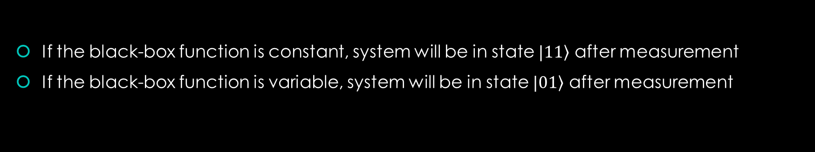


The Deutsch oracle
How do we solve it on a quantum computer in one query?
$$\left.|0\right\rangle$$
Control
X
H
BB
H
Target
$$\left.|0\right\rangle$$
H
X
H
If the black-box function is constant, system will be in state $\left.|11\right\rangle$ after measurement
If the black-box function is variable, system will be in state $\left.|01\right\rangle$ after measurement
Notes:
The white box indicates a measurement operation (note that measurements are nonreversible).
Note that we break the assumption in the black box that the initial value of the output qbit is 0

Slide 37








The Deutsch oracle: preprocessing
Control qbit
Target qbit
$$\left({0 \atop 1}\right)$$
$$\left({0 \atop 1}\right)$$
$$\left({\frac{−1}{\sqrt{2}} \atop \frac{1}{\sqrt{2}}}\right)$$
$$\left({\frac{1}{\sqrt{2}} \atop \frac{1}{\sqrt{2}}}\right)$$
$$\left({\frac{−1}{\sqrt{2}} \atop \frac{1}{\sqrt{2}}}\right)$$
$$\left({\frac{1}{\sqrt{2}} \atop \frac{1}{\sqrt{2}}}\right)$$
$$\left({−1 \atop 0}\right)$$
$$\left({1 \atop 0}\right)$$
$$\left({−1 \atop 0}\right)$$
$$\left({1 \atop 0}\right)$$
$$\left({\frac{−1}{\sqrt{2}} \atop \frac{−1}{\sqrt{2}}}\right)$$
$$\left({\frac{1}{\sqrt{2}} \atop \frac{−1}{\sqrt{2}}}\right)$$
$$\left({\frac{−1}{\sqrt{2}} \atop \frac{−1}{\sqrt{2}}}\right)$$
$$\left({\frac{1}{\sqrt{2}} \atop \frac{−1}{\sqrt{2}}}\right)$$
$$\left({0 \atop −1}\right)$$
$$\left({0 \atop −1}\right)$$
Notes:
State before being sent into black box

Slide 38
The Deutsch oracle: constant-0
BB
$$\left.|x\right\rangle$$
$$|\left.x\right\rangle$$
Control
$$|\left.0\right\rangle$$
$$|\left.0\right\rangle$$
Target

Slide 39

The Deutsch oracle: constant-0
Control qbit
Target qbit
$$\left({0 \atop 1}\right)$$
$$\left({0 \atop 1}\right)$$
$$\left({\frac{−1}{\sqrt{2}} \atop \frac{1}{\sqrt{2}}}\right)$$
$$\left({\frac{1}{\sqrt{2}} \atop \frac{1}{\sqrt{2}}}\right)$$
$$\left({\frac{−1}{\sqrt{2}} \atop \frac{1}{\sqrt{2}}}\right)$$
$$\left({\frac{1}{\sqrt{2}} \atop \frac{1}{\sqrt{2}}}\right)$$
$$\left({−1 \atop 0}\right)$$
$$\left({1 \atop 0}\right)$$
$$\left({−1 \atop 0}\right)$$
$$\left({1 \atop 0}\right)$$
$$\left({\frac{−1}{\sqrt{2}} \atop \frac{−1}{\sqrt{2}}}\right)$$
$$\left({\frac{1}{\sqrt{2}} \atop \frac{−1}{\sqrt{2}}}\right)$$
$$\left({\frac{−1}{\sqrt{2}} \atop \frac{−1}{\sqrt{2}}}\right)$$
$$\left({\frac{1}{\sqrt{2}} \atop \frac{−1}{\sqrt{2}}}\right)$$
$$\left({0 \atop −1}\right)$$
$$\left({0 \atop −1}\right)$$
Result: $\left.|11\right\rangle$
Notes:
Constant-0 function has no gates, so just perform post-process Hadamard transform.

Slide 40
The Deutsch oracle: constant-1
BB
$$\left.|x\right\rangle$$
$$|\left.x\right\rangle$$
Control
$$|\left.0\right\rangle$$
X
$$|\left.1\right\rangle$$
Target

Slide 41
The Deutsch oracle: constant-1
Control qbit
Target qbit
$$\left({0 \atop 1}\right)$$
$$\left({0 \atop 1}\right)$$
$$\left({\frac{−1}{\sqrt{2}} \atop \frac{1}{\sqrt{2}}}\right)$$
$$\left({\frac{1}{\sqrt{2}} \atop \frac{1}{\sqrt{2}}}\right)$$
$$\left({\frac{−1}{\sqrt{2}} \atop \frac{1}{\sqrt{2}}}\right)$$
$$\left({\frac{1}{\sqrt{2}} \atop \frac{1}{\sqrt{2}}}\right)$$
$$\left({−1 \atop 0}\right)$$
$$\left({1 \atop 0}\right)$$
$$\left({−1 \atop 0}\right)$$
$$\left({1 \atop 0}\right)$$
$$\left({\frac{−1}{\sqrt{2}} \atop \frac{−1}{\sqrt{2}}}\right)$$
$$\left({\frac{1}{\sqrt{2}} \atop \frac{−1}{\sqrt{2}}}\right)$$
$$\left({\frac{−1}{\sqrt{2}} \atop \frac{−1}{\sqrt{2}}}\right)$$
$$\left({\frac{1}{\sqrt{2}} \atop \frac{−1}{\sqrt{2}}}\right)$$
$$\left({0 \atop −1}\right)$$
$$\left({0 \atop −1}\right)$$
Result: $\left.|11\right\rangle$
Notes:
Constant-1 circuit has a single bit-flip gate on the output qbit.
See how the action of the bit flip gate is neutralized

Slide 42
The Deutsch oracle: identity
BB
$$\left.|x\right\rangle$$
$$|\left.x\right\rangle$$
Control
$$|\left.0\right\rangle$$
$$|\left.x\right\rangle$$
Target
Notes:
This is a CNOT gate; the dot indicates control bit, the o-plus symbol the target bit

Slide 43

The Deutsch oracle: identity
Control qbit
Target qbit
$$\left({0 \atop 1}\right)$$
$$\left({0 \atop 1}\right)$$
$$\left({\frac{−1}{\sqrt{2}} \atop \frac{1}{\sqrt{2}}}\right)$$
$$\left({\frac{1}{\sqrt{2}} \atop \frac{1}{\sqrt{2}}}\right)$$
$$\left({\frac{−1}{\sqrt{2}} \atop \frac{1}{\sqrt{2}}}\right)$$
$$\left({\frac{1}{\sqrt{2}} \atop \frac{1}{\sqrt{2}}}\right)$$
$$\left({−1 \atop 0}\right)$$
$$\left({1 \atop 0}\right)$$
$$\left({−1 \atop 0}\right)$$
$$\left({1 \atop 0}\right)$$
$$\left({\frac{−1}{\sqrt{2}} \atop \frac{−1}{\sqrt{2}}}\right)$$
$$\left({\frac{1}{\sqrt{2}} \atop \frac{−1}{\sqrt{2}}}\right)$$
$$\left({\frac{−1}{\sqrt{2}} \atop \frac{−1}{\sqrt{2}}}\right)$$
$$\left({\frac{1}{\sqrt{2}} \atop \frac{−1}{\sqrt{2}}}\right)$$
$$\left({0 \atop −1}\right)$$
$$\left({0 \atop −1}\right)$$
Result: $\left.|01\right\rangle$
Notes:
Green arrow indicates action of CNOT gate (see next slide for mathematical derivation; this is a limitation of our unit circle visualization)
Note output qbit is unaffected by CNOT gate

Slide 44

The Deutsch oracle: identity
$$C\left(\left({\frac{1}{\sqrt{2}} \atop \frac{−1}{\sqrt{2}}}\right)⊗\left({\frac{1}{\sqrt{2}} \atop \frac{−1}{\sqrt{2}}}\right)\right)=C\left(\begin{matrix}\frac{1}{2} \\ \frac{−1}{2} \\ \begin{matrix}\frac{−1}{2} \\ \frac{1}{2}\end{matrix}\end{matrix}\right)=\frac{1}{2}\left(\begin{matrix}\begin{matrix}1 & 0 \\ 0 & 1\end{matrix} & \begin{matrix}0 & 0 \\ 0 & 0\end{matrix} \\ \begin{matrix}0 & 0 \\ 0 & 0\end{matrix} & \begin{matrix}0 & 1 \\ 1 & 0\end{matrix}\end{matrix}\right)\left(\begin{matrix}1 \\ −1 \\ \begin{matrix}−1 \\ 1\end{matrix}\end{matrix}\right)=\frac{1}{2}\left(\begin{matrix}1 \\ −1 \\ \begin{matrix}1 \\ −1\end{matrix}\end{matrix}\right)=\left({\frac{1}{\sqrt{2}} \atop \frac{1}{\sqrt{2}}}\right)⊗\left({\frac{1}{\sqrt{2}} \atop \frac{−1}{\sqrt{2}}}\right)$$
Notes:
In the right-most step, we factor the product state back into individual qbits
After going through the math, note the final action on the input and output qbits: output qbit is unchanged, input qbit becomes all positive.

Slide 45
The Deutsch oracle: negation
BB
$$\left.|x\right\rangle$$
$$|\left.x\right\rangle$$
Control
$$|\left.0\right\rangle$$
X
$$|\left.¬x\right\rangle$$
Target

Slide 46
The Deutsch oracle: negation
Control qbit
Target qbit
$$\left({0 \atop 1}\right)$$
$$\left({0 \atop 1}\right)$$
$$\left({\frac{−1}{\sqrt{2}} \atop \frac{1}{\sqrt{2}}}\right)$$
$$\left({\frac{1}{\sqrt{2}} \atop \frac{1}{\sqrt{2}}}\right)$$
$$\left({\frac{−1}{\sqrt{2}} \atop \frac{1}{\sqrt{2}}}\right)$$
$$\left({\frac{1}{\sqrt{2}} \atop \frac{1}{\sqrt{2}}}\right)$$
$$\left({−1 \atop 0}\right)$$
$$\left({1 \atop 0}\right)$$
$$\left({−1 \atop 0}\right)$$
$$\left({1 \atop 0}\right)$$
$$\left({\frac{−1}{\sqrt{2}} \atop \frac{−1}{\sqrt{2}}}\right)$$
$$\left({\frac{1}{\sqrt{2}} \atop \frac{−1}{\sqrt{2}}}\right)$$
$$\left({\frac{−1}{\sqrt{2}} \atop \frac{−1}{\sqrt{2}}}\right)$$
$$\left({\frac{1}{\sqrt{2}} \atop \frac{−1}{\sqrt{2}}}\right)$$
$$\left({0 \atop −1}\right)$$
$$\left({0 \atop −1}\right)$$
Result: $\left.|01\right\rangle$
Notes:
Recall negation has a CNOT gate plus a bit flip gate
See how the action of the bit-flip gate is again neutralized

Slide 47
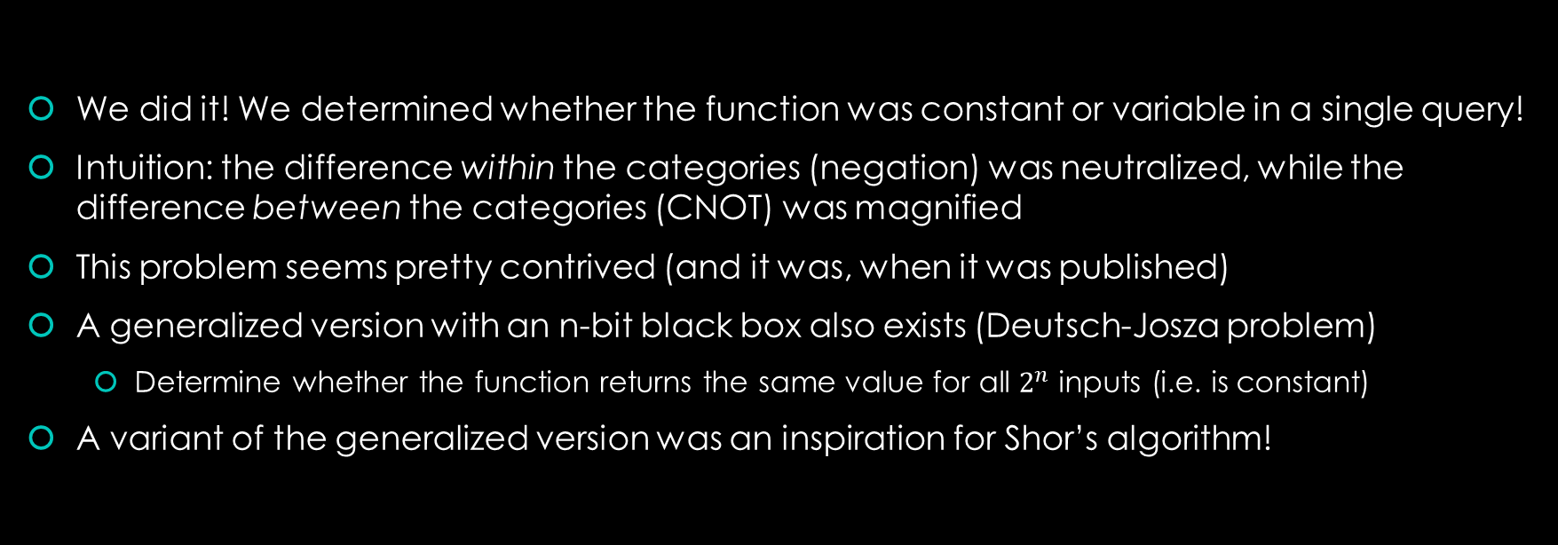
The Deutsch oracle
We did it! We determined whether the function was constant or variable in a single query!
Intuition: the difference within the categories (negation) was neutralized, while the difference between the categories (CNOT) was magnified
This problem seems pretty contrived (and it was, when it was published)
A generalized version with an n-bit black box also exists (Deutsch-Josza problem)
  Determine whether the function returns the same value for all $2^{n}$ inputs (i.e. is constant)
A variant of the generalized version was an inspiration for Shor’s algorithm!

Slide 48
Full recap
We learned how to model classical computation with basic linear algebra
We learned about qbits, superposition, and the Hadamard gate
We learned the Deutsch Oracle problem, where quantum outperforms classical

Slide 49
Bonus topics
Quantum entanglement
Quantum teleportation

Slide 50

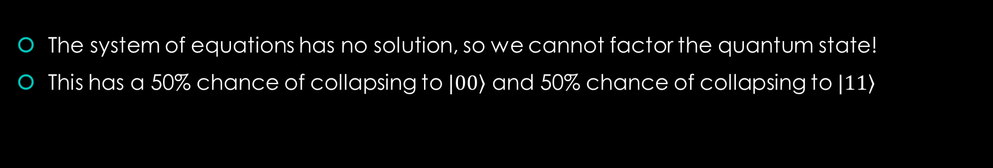

Entanglement
If the product state of two qbits cannot be factored, they are said to be entangled
$$\left(\begin{matrix}\frac{1}{\sqrt{2}} \\ 0 \\ \begin{matrix}0 \\ \frac{1}{\sqrt{2}}\end{matrix}\end{matrix}\right)=\left({a \atop b}\right)⊗\left({c \atop d}\right)$$
$$ac=\frac{1}{\sqrt{2}}$$
$$ad=0$$
$$bc=0$$
$$bd=\frac{1}{\sqrt{2}}$$
The system of equations has no solution, so we cannot factor the quantum state!
This has a 50% chance of collapsing to $\left.|00\right\rangle$ and 50% chance of collapsing to $\left.|11\right\rangle$

Slide 51



Entanglement
How can we reach an entangled state? Easy!
$$\left.|0\right\rangle$$
H
$$\left.|0\right\rangle$$
$$CH_{1}\left(\left({1 \atop 0}\right)⊗\left({1 \atop 0}\right)\right)=C\left(\left({\frac{1}{\sqrt{2}} \atop \frac{1}{\sqrt{2}}}\right)⊗\left({1 \atop 0}\right)\right)=\left(\begin{matrix}\begin{matrix}1 & 0 \\ 0 & 1\end{matrix} & \begin{matrix}0 & 0 \\ 0 & 0\end{matrix} \\ \begin{matrix}0 & 0 \\ 0 & 0\end{matrix} & \begin{matrix}0 & 1 \\ 1 & 0\end{matrix}\end{matrix}\right)\left(\begin{matrix}\frac{1}{\sqrt{2}} \\ 0 \\ \begin{matrix}\frac{1}{\sqrt{2}} \\ 0\end{matrix}\end{matrix}\right)=\left(\begin{matrix}\frac{1}{\sqrt{2}} \\ 0 \\ \begin{matrix}0 \\ \frac{1}{\sqrt{2}}\end{matrix}\end{matrix}\right)$$
Notes:
This is why quantum computers take exponential resources to simulate on a classical computer
Since we cannot factor the product state, we have to maintain track of a vector of 2^{n} values
Many/most interesting quantum algorithms end up entangling a bunch of the qbits

Slide 52
Entanglement
What’s going on here? The qbits seem to be coordinating in some way
  Measuring one qbit also collapses the other in a correlated state
This coordination happens even across vast stretches of space
The coordination even happens faster than the speed of light! It is instantaneous.
Entanglement breaks locality through faster-than-light coordination
  However – and this is the critical part – no information can be communicated
Notes:
Einstein: “spooky action at a distance”, (Einstein-Podolsky-Rosen) EPR paradox
Hilariously the EPR paradox basically posited the existence of quantum entanglement, with the implicit message that “this is obviously ridiculous therefore quantum mechanics is garbage”
From experiments it turns out that this ridiculousness is actually how it works
Note that you cannot tell whether your qbit is still in superposition, so you can’t use the act of measuring/collapsing for faster-than-light synchronization

Slide 53
Entanglement
Surely the qbits just decided at time of entanglement how they would collapse?
  This is called a “local hidden variable” theory, since the qbits carry information with them
In 1964, John Bell proposed an experiment to differentiate between decide-at-entanglement and decide-at-collapse theories; these are called Bell test experiments
All such experiments have come down firmly against local hidden variables
Locality is a lie; our universe’s physics is fundamentally nonlocal

Slide 54
Teleportation
Quantum teleportation is the process by which the state of an arbitrary qbit is transferred from one location to another by way of two other entangled qbits
You can transfer qbit states (cut & paste) but you cannot clone them (copy & paste)
  This is called the No-cloning theorem
The teleportation is not faster-than-light, because some classical information must be sent
Notes:
The no-cloning theorem is actually straightforward to prove, you just show that any action which clones a qbit cannot be unitary

Slide 55








Teleportation
$$|\left.ψ\right\rangle$$
H
$$T$$
$$\left.|0\right\rangle$$
$$Z=\left(\begin{matrix}1 & 0 \\ 0 & −1\end{matrix}\right)$$
$$A$$
H
$$\left.|0\right\rangle$$
X
Z
$$|\left.ψ\right\rangle$$
$$B$$
Notes:
The qbit to be teleported is T, with value $|\left.ψ\right\rangle$
Qbits A and B are entangled then separated; Alice keeps A and T, Bob gets B
Alice measures A and T, then sends measured values to Bob over a classical channel
Bob conditionally applies the bit-flip (X) and phase-flip (Z) gates to qbit B, ending up with $|\left.ψ\right\rangle$
A long period of time can pass between entangling qbits A and B and teleporting the phi qbit
You can pre-share a bunch of entangled qbits (called EPR halves), store them, and teleport qbits as needed
Not dissimilar from the mechanics of a cryptographic one-time pad: pre-share a large amount of random data for a private key, then use up the private key as needed for secure communication (note this comparison has nothing to do with the secure communication capabilities of teleportation)

Slide 56
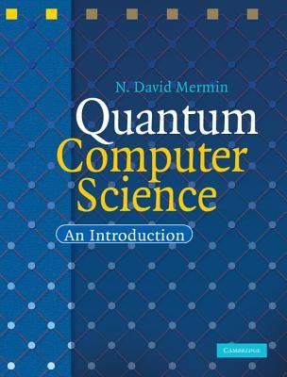
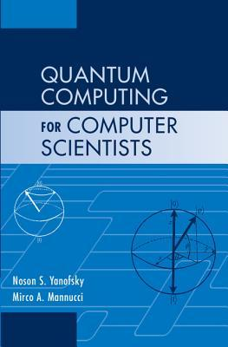
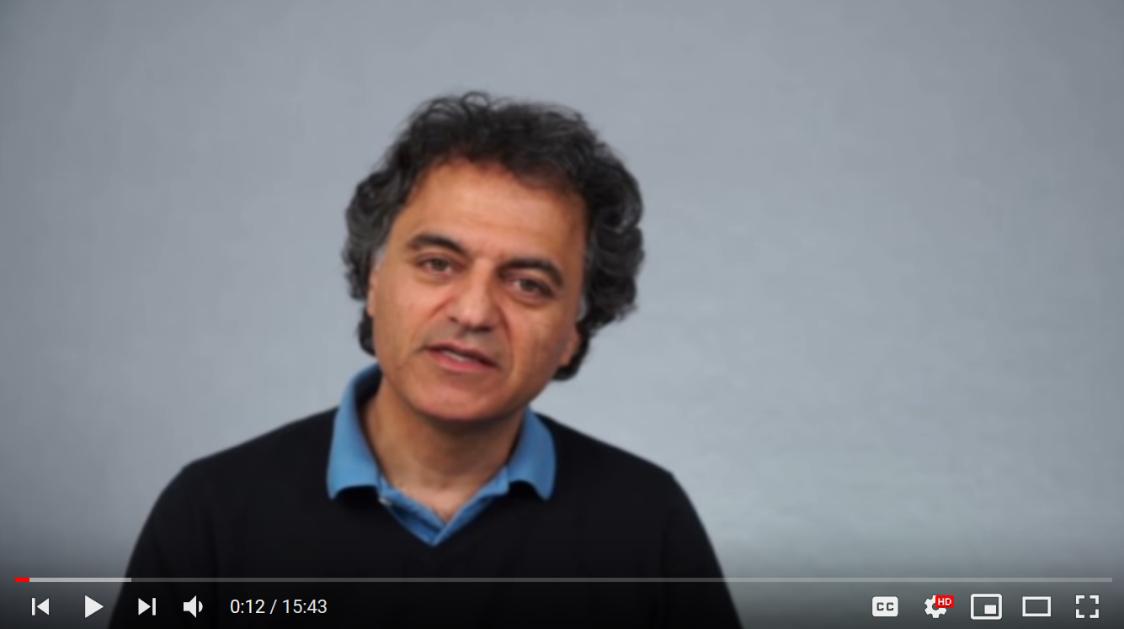
Sources
Prof. Umesh Vazirani
CS191x MOOC

Slide 57
Further learning goals
Deutsch-Jozsa algorithm and Simon’s periodicity problem
  Former yields oracle separation between EQP and P, latter between BQP and BPP
Shor’s algorithm and Grover’s algorithm
Quantum cryptographic key exchange
How qbits, gates, and measurement are actually implemented
Quantum error correction
Quantum programming language design
Notes:
EQP – Exact Quantum Polynomial-Time (quantum algorithm returns correct answer with probability 1)
P – Polynomial time (solvable in polynomial time by a classical computer)
BPP – Bounded-Error Probabilistic Polynomial-Time
BQP – Bounded-Error Quantum Polynomial Time

Slide 58
Further reading
Recommended textbook: Quantum Computing for Computer Scientists
  Others have recommended Quantum Computing: A Gentle Introduction
  For those with heavier math backgrounds, Quantum Computer Science: An Introduction
The Microsoft Quantum Development Kit docs are nice [link]
  The development kit contains a quantum computer simulator!
  Exercise: implement the Deutsch Oracle tester in Q#
Some skepticism about physically-realizable quantum computers [link]
  Noise might increase exponentially with the number of physical qbits
Notes:
The gentle introduction and QCS textbooks are available as an ebook in mslibrary
QCS textbook is by David Mermin (“shut up and calculate”)

Slide 59
Appendices
Mathematical definition of superposition
Single-bit operations on multi-bit states
Quantum teleportation math

Slide 60

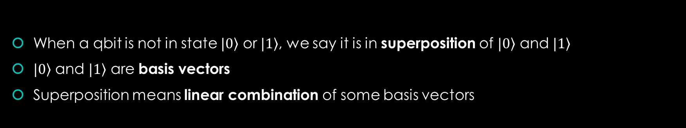
Superposition as linear combination
When a qbit is not in state $|\left.0\right\rangle$ or $|\left.1\right\rangle$, we say it is in superposition of $|\left.0\right\rangle$ and $|\left.1\right\rangle$
$|\left.0\right\rangle$ and $|\left.1\right\rangle$ are basis vectors
Superposition means linear combination of some basis vectors
$$\left({a \atop b}\right)=a\left({1 \atop 0}\right)+b\left({0 \atop 1}\right)=a|\left.0\right\rangle +b|\left.1\right\rangle$$

Slide 61


Review: matrix multiplication associativity
$$\left(AB\right)x=A(Bx)$$
$$\left(\left(\begin{matrix}0 & 1 \\ 1 & 0\end{matrix}\right)\left(\begin{matrix}0 & 1 \\ 1 & 0\end{matrix}\right)\right)\left({a \atop b}\right)=\left(\begin{matrix}0 & 1 \\ 1 & 0\end{matrix}\right)\left(\left(\begin{matrix}0 & 1 \\ 1 & 0\end{matrix}\right)\left({a \atop b}\right)\right)$$
$$\left(\begin{matrix}1 & 0 \\ 0 & 1\end{matrix}\right)\left({a \atop b}\right)=\left(\begin{matrix}0 & 1 \\ 1 & 0\end{matrix}\right)\left({b \atop a}\right)$$
$$\left({a \atop b}\right)=\left({a \atop b}\right)$$
$$(HXH)x=Zx \\ \left(\frac{1}{2}\left(\begin{matrix}1 & 1 \\ 1 & −1\end{matrix}\right)\left(\begin{matrix}0 & 1 \\ 1 & 0\end{matrix}\right)\left(\begin{matrix}1 & 1 \\ 1 & −1\end{matrix}\right)\right)\left({α \atop β}\right)=\left(\begin{matrix}1 & 0 \\ 0 & −1\end{matrix}\right)\left({α \atop β}\right) \\ \left(\frac{1}{2}\left(\begin{matrix}1 & 1 \\ 1 & −1\end{matrix}\right)\left(\begin{matrix}1 & −1 \\ 1 & 1\end{matrix}\right)\right)\left({α \atop β}\right)=\left({α \atop −β}\right) \\ \left(\begin{matrix}1 & 0 \\ 0 & −1\end{matrix}\right)\left({α \atop β}\right)=\left({α \atop −β}\right) \\ \left({α \atop −β}\right)=\left({α \atop −β}\right)$$
You only have to care about the cumulative effect of a series of gates; the specific sequence changes nothing.
Notes:
If we’re applying multiple transformations in a row, we can combine them into a single matrix for simplicity.
The Z gate is also called the “phase-flip” gate.
This is the reason why the Deutsch Oracle problem is not trivial: we are using the cumulative action of the function, not just taking advantage of the specific circuit structure.

Slide 62
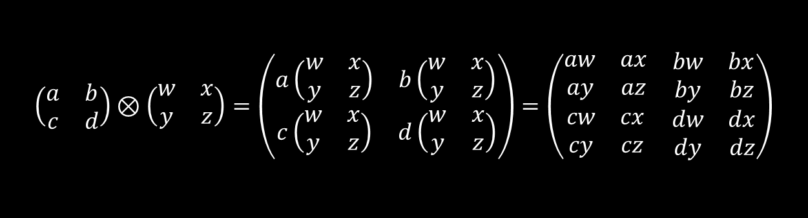
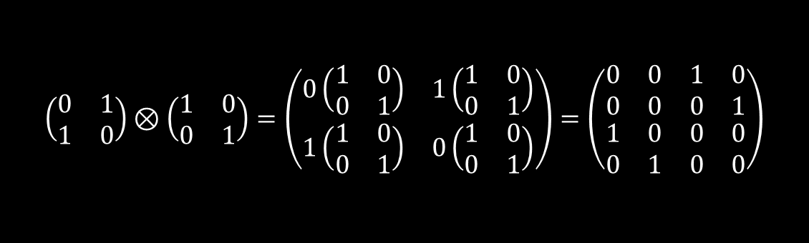
Review: tensor product of matrices
$$\left(\begin{matrix}a & b \\ c & d\end{matrix}\right)⊗\left(\begin{matrix}w & x \\ y & z\end{matrix}\right)=\left(\begin{matrix}a\left(\begin{matrix}w & x \\ y & z\end{matrix}\right) & b\left(\begin{matrix}w & x \\ y & z\end{matrix}\right) \\ c\left(\begin{matrix}w & x \\ y & z\end{matrix}\right) & d\left(\begin{matrix}w & x \\ y & z\end{matrix}\right)\end{matrix}\right)=\left(\begin{matrix}\begin{matrix}aw & ax \\ ay & az\end{matrix} & \begin{matrix}bw & bx \\ by & bz\end{matrix} \\ \begin{matrix}cw & cx \\ cy & cz\end{matrix} & \begin{matrix}dw & dx \\ dy & dz\end{matrix}\end{matrix}\right)$$
$$\left(\begin{matrix}0 & 1 \\ 1 & 0\end{matrix}\right)⊗\left(\begin{matrix}1 & 0 \\ 0 & 1\end{matrix}\right)=\left(\begin{matrix}0\left(\begin{matrix}1 & 0 \\ 0 & 1\end{matrix}\right) & 1\left(\begin{matrix}1 & 0 \\ 0 & 1\end{matrix}\right) \\ 1\left(\begin{matrix}1 & 0 \\ 0 & 1\end{matrix}\right) & 0\left(\begin{matrix}1 & 0 \\ 0 & 1\end{matrix}\right)\end{matrix}\right)=\left(\begin{matrix}\begin{matrix}0 & 0 \\ 0 & 0\end{matrix} & \begin{matrix}1 & 0 \\ 0 & 1\end{matrix} \\ \begin{matrix}1 & 0 \\ 0 & 1\end{matrix} & \begin{matrix}0 & 0 \\ 0 & 0\end{matrix}\end{matrix}\right)$$
Notes:
Think of this like tiling the matrix on the right

Slide 63
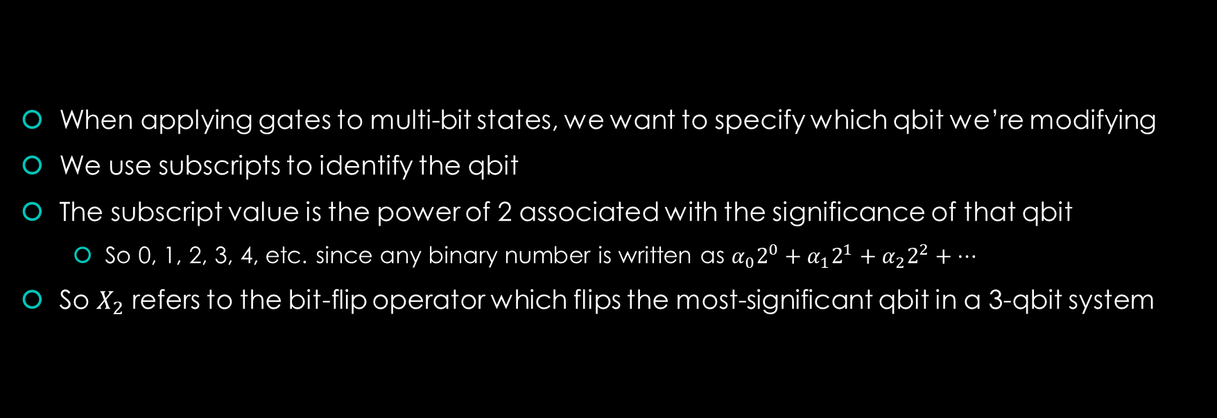
Single-bit operations on multi-bit states
When applying gates to multi-bit states, we want to specify which qbit we’re modifying
We use subscripts to identify the qbit
The subscript value is the power of 2 associated with the significance of that qbit
  So 0, 1, 2, 3, 4, etc. since any binary number is written as $α_{0}2^{0}+α_{1}2^{1}+α_{2}2^{2}+…$
So $X_{2}$ refers to the bit-flip operator which flips the most-significant qbit in a 3-qbit system

Slide 64

Single-bit operations on multi-bit states
What if we want to operate on a single bit in the product state? What matrix do we use?
Example - flip the least-significant bit:
$$X_{0}\left.|01\right\rangle =\left(\left(\begin{matrix}1 & 0 \\ 0 & 1\end{matrix}\right)⊗\left(\begin{matrix}0 & 1 \\ 1 & 0\end{matrix}\right)\right)\left(\begin{matrix}0 \\ 1 \\ \begin{matrix}0 \\ 0\end{matrix}\end{matrix}\right)=\left(\begin{matrix}\begin{matrix}0 & 1 \\ 1 & 0\end{matrix} & \begin{matrix}0 & 0 \\ 0 & 0\end{matrix} \\ \begin{matrix}0 & 0 \\ 0 & 0\end{matrix} & \begin{matrix}0 & 1 \\ 1 & 0\end{matrix}\end{matrix}\right)\left(\begin{matrix}0 \\ 1 \\ \begin{matrix}0 \\ 0\end{matrix}\end{matrix}\right)=\left(\begin{matrix}1 \\ 0 \\ \begin{matrix}0 \\ 0\end{matrix}\end{matrix}\right)=\left.|00\right\rangle$$
The operation we want is tensored with the identity matrix, in the position matching the significance of that bit.

Slide 65

Single-bit operations on multi-bit states
We can also tensor multiple one-bit operators together to operate on bits in parallel.
Example – flip both bits:
$${X_{1}X}_{0}\left.|01\right\rangle =\left(\left(\begin{matrix}0 & 1 \\ 1 & 0\end{matrix}\right)⊗\left(\begin{matrix}0 & 1 \\ 1 & 0\end{matrix}\right)\right)\left(\begin{matrix}0 \\ 1 \\ \begin{matrix}0 \\ 0\end{matrix}\end{matrix}\right)=\left(\begin{matrix}\begin{matrix}0 & 0 \\ 0 & 0\end{matrix} & \begin{matrix}0 & 1 \\ 1 & 0\end{matrix} \\ \begin{matrix}0 & 1 \\ 1 & 0\end{matrix} & \begin{matrix}0 & 0 \\ 0 & 0\end{matrix}\end{matrix}\right)\left(\begin{matrix}0 \\ 1 \\ \begin{matrix}0 \\ 0\end{matrix}\end{matrix}\right)=\left(\begin{matrix}0 \\ 0 \\ \begin{matrix}1 \\ 0\end{matrix}\end{matrix}\right)=\left.|10\right\rangle$$
Many useful operators are products of one-bit operators, but some (like CNOT) cannot be factored that way.

Slide 66
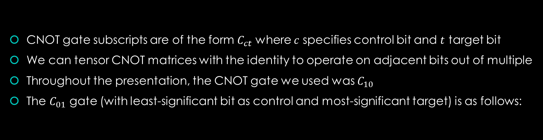

Single-bit operations on multi-bit states
CNOT gate subscripts are of the form $C_{ct}$ where $c$ specifies control bit and $t$ target bit
We can tensor CNOT matrices with the identity to operate on adjacent bits out of multiple
Throughout the presentation, the CNOT gate we used was $C_{10}$
The $C_{01}$ gate (with least-significant bit as control and most-significant target) is as follows:
$$00$$
$$00$$
$$C_{01}=\left(\begin{matrix}\begin{matrix}1 & 0 \\ 0 & 0\end{matrix} & \begin{matrix}0 & 0 \\ 0 & 1\end{matrix} \\ \begin{matrix}0 & 0 \\ 0 & 1\end{matrix} & \begin{matrix}1 & 0 \\ 0 & 0\end{matrix}\end{matrix}\right)$$
$$01$$
$$01$$
$$10$$
$$10$$
$$11$$
$$11$$

Slide 67
Quantum teleportation math
$$|\left.ψ\right\rangle$$
H
$$T$$
$$\left.|0\right\rangle$$
$$Z=\left(\begin{matrix}1 & 0 \\ 0 & −1\end{matrix}\right)$$
$$A$$
H
$$\left.|0\right\rangle$$
X
Z
$$|\left.ψ\right\rangle$$
$$B$$
Notes:
The qbit to be teleported is T, with value $|\left.ψ\right\rangle$
Qbits A and B are entangled then separated; Alice keeps A and T, Bob gets B
Alice measures A and T, then sends measured values to Bob over a classical channel
Bob conditionally applies the bit-flip (X) and phase-flip (Z) gates to qbit B, ending up with $|\left.ψ\right\rangle$
A long period of time can pass between entangling qbits A and B and teleporting the phi qbit
You can pre-share a bunch of entangled qbits (called EPR halves), store them, and teleport qbits as needed
Not dissimilar from the mechanics of a cryptographic one-time pad: pre-share a large amount of random data for a private key, then use up the private key as needed for secure communication (note this comparison has nothing to do with the secure communication capabilities of teleportation)

Slide 68
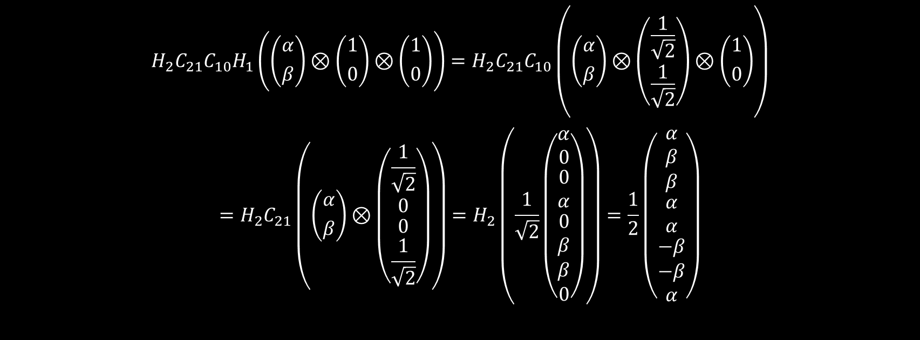
Quantum teleportation math
$${{{H_{2}C}_{21}C}_{10}H}_{1}\left(\left({α \atop β}\right)⊗\left({1 \atop 0}\right)⊗\left({1 \atop 0}\right)\right)={{H_{2}C}_{21}C}_{10}\left(\left({α \atop β}\right)⊗\left({\frac{1}{\sqrt{2}} \atop \frac{1}{\sqrt{2}}}\right)⊗\left({1 \atop 0}\right)\right)$$
$$={H_{2}C}_{21}\left(\left({α \atop β}\right)⊗\left(\begin{matrix}\frac{1}{\sqrt{2}} \\ 0 \\ \begin{matrix}0 \\ \frac{1}{\sqrt{2}}\end{matrix}\end{matrix}\right)\right)=H_{2}\left(\frac{1}{\sqrt{2}}\left(\begin{matrix}α \\ 0 \\ \begin{matrix}0 \\ α \\ \begin{matrix}0 \\ β \\ \begin{matrix}β \\ 0\end{matrix}\end{matrix}\end{matrix}\end{matrix}\right)\right)=\frac{1}{2}\left(\begin{matrix}α \\ β \\ \begin{matrix}β \\ \begin{matrix}α \\ α \\ \begin{matrix}−β \\ −β \\ α\end{matrix}\end{matrix}\end{matrix}\end{matrix}\right)$$

Slide 69

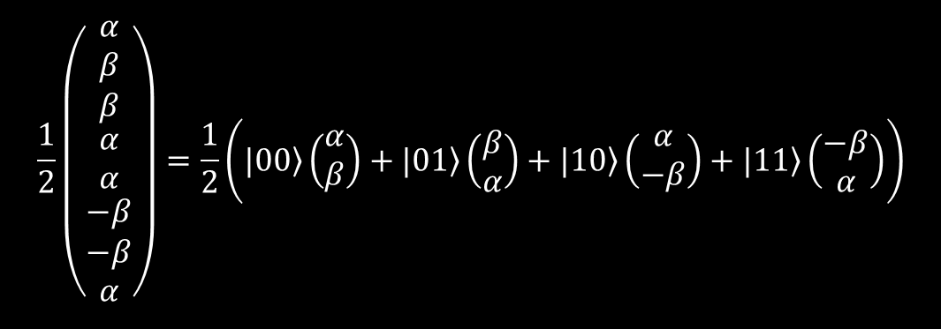







Quantum teleportation math
The state right before measurement breaks down into four cases:
$$\frac{1}{2}\left(\begin{matrix}α \\ β \\ \begin{matrix}β \\ \begin{matrix}α \\ α \\ \begin{matrix}−β \\ −β \\ α\end{matrix}\end{matrix}\end{matrix}\end{matrix}\right)=\frac{1}{2}\left(|0\left.0\right\rangle \left(\begin{matrix}α \\ β\end{matrix}\right)+\left.|01\right\rangle \left(\begin{matrix}β \\ α\end{matrix}\right)+|\left.10\right\rangle \left(\begin{matrix}α \\ −β\end{matrix}\right)+|\left.11\right\rangle \left(\begin{matrix}−β \\ α\end{matrix}\right)\right)$$
$$|0\left.0\right\rangle$$
$$\left(\begin{matrix}α \\ β\end{matrix}\right)$$
$$|0\left.1\right\rangle$$
$$\left(\begin{matrix}β \\ α\end{matrix}\right)$$
$$|1\left.0\right\rangle$$
$$\left(\begin{matrix}α \\ −β\end{matrix}\right)$$
$$|\left.11\right\rangle$$
$$\left(\begin{matrix}−β \\ α\end{matrix}\right)$$
When Alice measures her two qbits, Bob’s qbit is forced into one of four states.
The bits measured by Alice determine the state into which Bob’s qbit was forced.
Bob needs to apply a transformation to get his qbit to the state that he wants.
Bob needs to know the values of Alice’s bits to know which transformation(s) to apply.

Slide 70
Quantum teleportation math
If Alice measured:
Then Bob has:
So Bob must apply:
$$|0\left.0\right\rangle$$
$$\left(\begin{matrix}α \\ β\end{matrix}\right)$$
$$I\left(\begin{matrix}α \\ β\end{matrix}\right)=\left(\begin{matrix}1 & 0 \\ 0 & 1\end{matrix}\right)\left(\begin{matrix}α \\ β\end{matrix}\right)=\left(\begin{matrix}α \\ β\end{matrix}\right)$$
$$|0\left.1\right\rangle$$
$$\left(\begin{matrix}β \\ α\end{matrix}\right)$$
$$X\left(\begin{matrix}β \\ α\end{matrix}\right)=\left(\begin{matrix}0 & 1 \\ 1 & 0\end{matrix}\right)\left(\begin{matrix}β \\ α\end{matrix}\right)=\left(\begin{matrix}α \\ β\end{matrix}\right)$$
$$|\left.10\right\rangle$$
$$\left(\begin{matrix}α \\ −β\end{matrix}\right)$$
$$Z\left(\begin{matrix}α \\ −β\end{matrix}\right)=\left(\begin{matrix}1 & 0 \\ 0 & −1\end{matrix}\right)\left(\begin{matrix}α \\ −β\end{matrix}\right)=\left(\begin{matrix}α \\ β\end{matrix}\right)$$
$$|1\left.1\right\rangle$$
$$\left(\begin{matrix}−β \\ α\end{matrix}\right)$$
$$ZX\left(\begin{matrix}−β \\ α\end{matrix}\right)=\left(\begin{matrix}1 & 0 \\ 0 & −1\end{matrix}\right)\left(\begin{matrix}0 & 1 \\ 1 & 0\end{matrix}\right)\left(\begin{matrix}−β \\ α\end{matrix}\right)=\left(\begin{matrix}α \\ β\end{matrix}\right)$$
Most-significant bit controls whether $Z$ gate is applied, least-significant controls $X$ gate.

